Slide 1

Machine Learning and its Application to Side-Channel Analysis
-Amal Almuhawwi, Aabha Bothera, Chris Limson

Slide 2
SIDE-CHANNEL ANALYSIS
Profiling SCA
Non-Profiling SCA

Slide 3

TRADITIONAL MACHINE LEARNING TECHNIQUES FOR SCA
Standard Process of ML
Types of ML Used for SCA
Evaluation of Traditional ML Techniques in SCA

Slide 4
Types of ML Used for SCA
Supervised ML Techniques
Unsupervised ML Techniques
Semi-Supervised ML Techniques

Slide 5
Supervised ML techniques
Support Vector Machines:
Random Forests:
Naive Bayes:

Slide 6
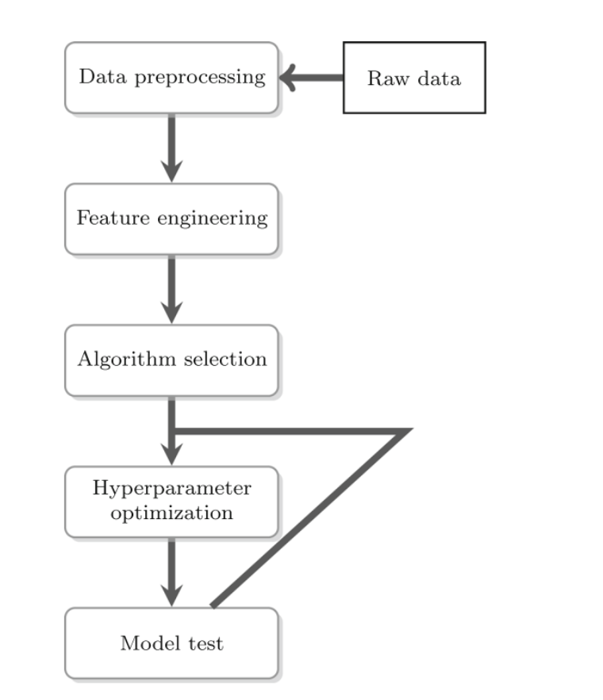
Standard Process of ML:

Slide 7
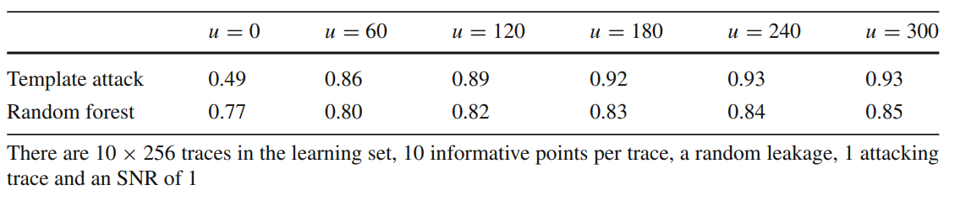
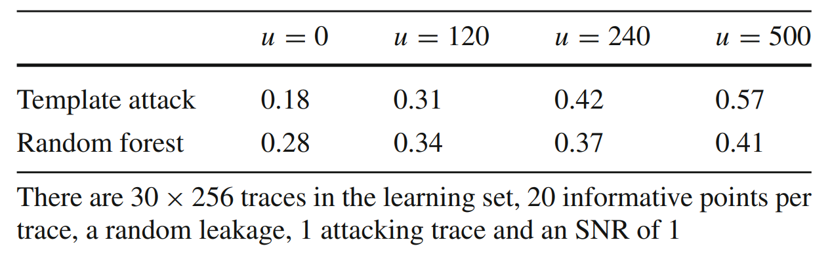
Comparing Traditional SCA to ML-based SCA [12]
Error rate of several profiled attacks as a function of the number
of irrelevant points per trace

Slide 8
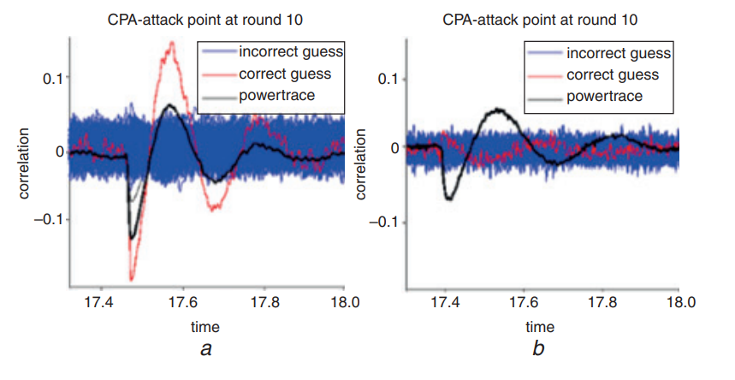
DIFFERENT APPLICATIONS OF ML TO SCA
Using ML as a Countermeasure for SCA [15]
Unprotected AES (500 traces)
(b) Protected AES (100,000 traces)

Slide 9
DEEP LEARNING TECHNIQUES FOR SCA
Multilayer Perceptron (MLP)
Convolutional Neural Networks (CNNs)
Evaluation of DL Techniques in SCA

Slide 10
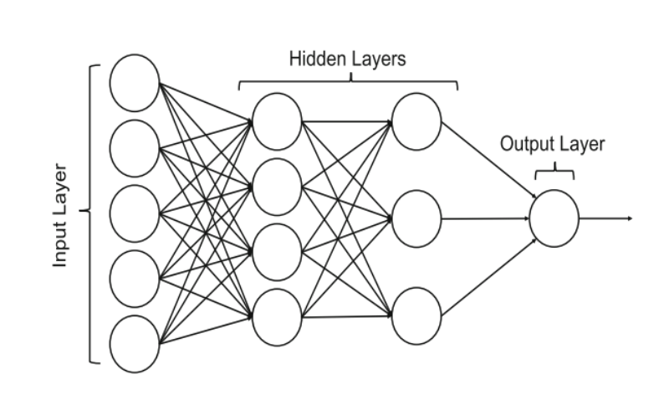
Multi-layer perceptron in SCA
Used in AES key classification.
Provides crisp classifications.
Suitable for attack success metrics.
Breaking mask-protected implementations.

Slide 11

Convolutional Neural Networks in SCA
Resilience against noise and countermeasures
Counters jitter-based hiding methods in AES encryption without pre-processing
Domain Knowledge (DK) neurons to enhance feature classification/regression
Against secure public key cryptosystems

Slide 12
Deep Learning in SCA
Regularisation Techniques in SCA
Hyper- Parameter Optimisation and Architectural Development
Visualisation and Model Interpretability

Slide 13
EXPERIMENT ON SIMULATED DATA
Algorithm:
Train model with datasets
Load model
Perform model prediction
For each of 16 bytes
Perform key prediction
Select highest probability
Aggregate results for recovered key

Slide 14
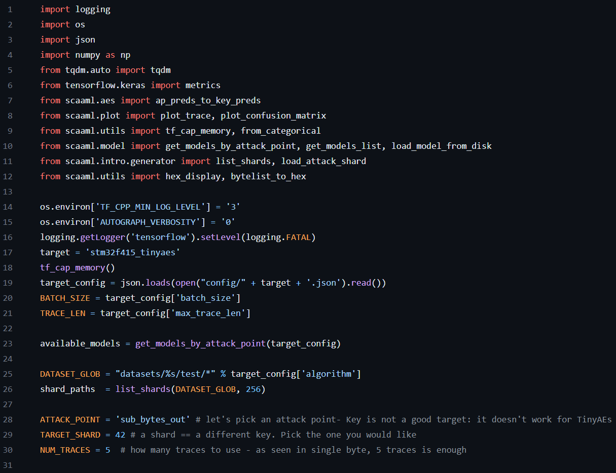
EXPERIMENT ON SIMULATED DATA
Source Code

Slide 15
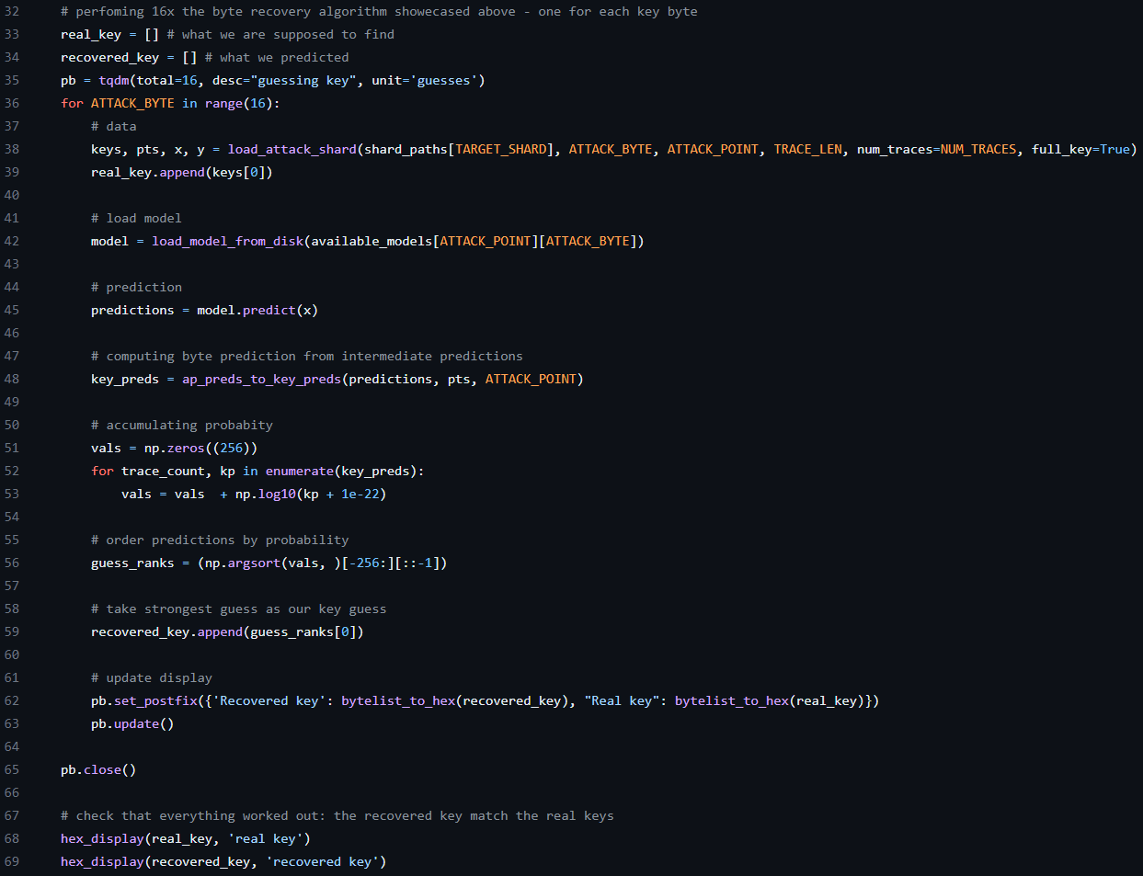
EXPERIMENT ON SIMULATED DATA
Source Code

Slide 16
EXPERIMENT ON SIMULATED DATA
Demonstration
From Side-Channel Attacks Assisted with Machine Learning (SCAAML)
Elie Bursztein and Jean-Michel Picod
TinyAES on STMicroelectronics STM32F415
AWS Ubuntu 22.04, 64x86
t2.xlarge 4vCPU 16 GiB
tensorflow-cpu
3 minutes 15 seconds (presented at 4x => 48 s)

Slide 17
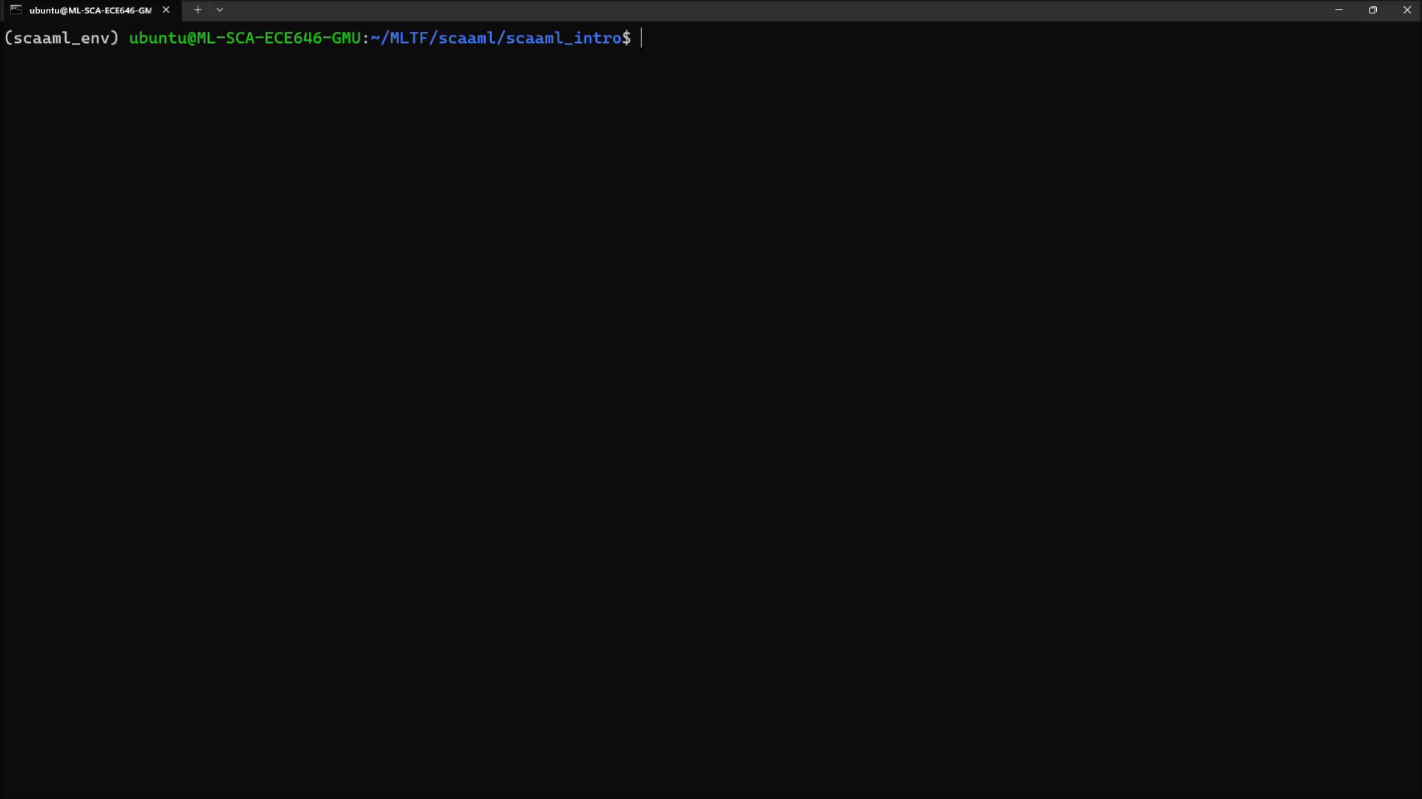

Slide 18
GUIDELINES FOR CONDUCTING ML IN SCA
Clarification of Preprocessing Techniques
Detailed Description of Hyperparameters
Explanation of Optimal Parameter Selection
Use of Multiple Performance Metrics
Application of Cross-Validation
Utilization of Learning Curves or Restricted Attacker Framework
Identification of Sensitive Components
Quantification of Attacker Overhead
Publication of Experiments and Data

Slide 19
REFERENCES
[1] Jovic, A., Jap, D., Papachristodoulou, L., & Heuser, A. (2022). Traditional Machine Learning Methods for Side-Channel Analysis. In Security and artificial intelligence: A crossdisciplinary approach to solving (pp. 25–47). essay, SPRINGER NATURE.
[2] Rijsdijk, J., Wu, L., Perin, G., & Picek, S. (2021). Reinforcement learning for hyperparameter tuning in deep learning-based side-channel analysis. IACR Transactions on Cryptographic Hardware and Embedded Systems, 677-707.
[3] Shan, W., Zhang, S., Xu, J., Lu, M., Shi, L., & Yang, J. (2019). Machine learning assisted side-channel-attack countermeasure and its application on a 28-nm AES circuit. IEEE Journal of Solid-State Circuits, 55(3), 794-804.
[4] Jin, S., Kim, S., Kim, H., & Hong, S. (2020). Recent advances in deep learning‐based side‐channel analysis. ETRI Journal, 42(2), 292-304.
[5] Picek, S., Heuser, A., Jovic, A., Ludwig, S. A., Guilley, S., Jakobovic, D., & Mentens, N. (2017, May). Side-channel analysis and machine learning: A practical perspective. In 2017 International Joint Conference on Neural Networks (IJCNN) (pp. 4095-4102). IEEE.
[6] Hettwer, B., Gehrer, S., & Güneysu, T. (2020). Applications of machine learning techniques in side-channel attacks: a survey. Journal of Cryptographic Engineering, 10, 135-162.
[7] Hospodar, G., Gierlichs, B., De Mulder, E., Verbauwhede, I., & Vandewalle, J. (2011). Machine learning in side-channel analysis: a first study. Journal of Cryptographic Engineering, 1(4), 293-302.
[8] Masure, L., Dumas, C., & Prouff, E. (2020). A comprehensive study of deep learning for side-channel analysis. IACR Transactions on Cryptographic Hardware and Embedded Systems, 348-375.
[9] Kerkhof, M., Wu, L., Perin, G.,Picek, S. (2023). No (good) loss no gain: systematic evaluation of loss functions in deep learning-based side-channel analysis. Journal of Cryptographic Engineering, 13,311–324
[10] Tehranipoor, S., Karimian, N., & Edmonds, J. (2023, July). Breaking AES-128: Machine Learning-Based SCA Under Different Scenarios and Devices. In 2023 IEEE International Conference on Cyber Security and Resilience (CSR) (pp. 564-571). IEEE.

Slide 20
REFERENCES(cont.)
[11] Maghrebi, H., Portigliatti, T., & Prouff, E. (2016). Breaking cryptographic implementations using deep learning techniques. In Security, Privacy, and Applied Cryptography Engineering: 6th International Conference, SPACE 2016, Hyderabad, India, December 14-18, 2016, Proceedings 6 (pp. 3-26). Springer International Publishing
[12] Lerman, L., Poussier, R., Markowitch, O., & Standaert, F. X. (2018). Template attacks versus machine learning revisited and the curse of dimensionality in side-channel analysis: extended version. Journal of Cryptographic Engineering, 8, 301-313.
[13] Saeedi, E., Hossain, M. S., & Kong, Y. (2015, July). Multi-class SVMs analysis of side-channel information of elliptic curve cryptosystem. In 2015 International Symposium on Performance Evaluation of Computer and Telecommunication Systems (SPECTS) (pp. 1-6). IEEE.
[14] Kim, J., Picek, S., Heuser, A., Bhasin, S., Hanjalic, A.: Make some noise: unleashing the power of convolutional neural networks for profiled side-channel analysis. Cryptology ePrint Archive, Report 2018/1023 (2018). https://eprint.iacr.org/2018/1023
[15] Shan, W., Zhang, S., & He, Y. (2017). Machine learning based side‐channel‐attack countermeasure with hamming‐distance redistribution and its application on advanced encryption standard. Electronics Letters, 53(14), 926-928.
[16] Bursztein, E. (2019). SCAAML: Side Channel Attacks Assisted with Machine Learning. GitHub. https://github.com/google/scaaml
[17] Carbone, M., Conin, V., Cornelie, M. A., Dassance, F., Dufresne, G., Dumas, C., ... & Venelli, A. (2019). Deep learning to evaluate secure RSA implementations. IACR Transactions on Cryptographic Hardware and Embedded Systems, 132-161.
[18] Timon, B. (2019). Non-profiled deep learning-based side-channel attacks with sensitivity analysis. IACR Transactions on Cryptographic Hardware and Embedded Systems, 107-131.
[19] Picek, S., Heuser, A., Guilley, S.: Profiling side-channel analysis in the restricted attacker framework. CryptologyePrint Archive, Report 2019/168. https://eprint.iacr.org/2019/168 (2019). Accessed 19 Mar 2019
[20] Langley, P.: Crafting papers on machine learning. In: Proceedings of the Seventeenth International Conference on Machine Learning (ICML), pp. 1207–1212 (2000)

Slide 21

Thank you

